Slide 1
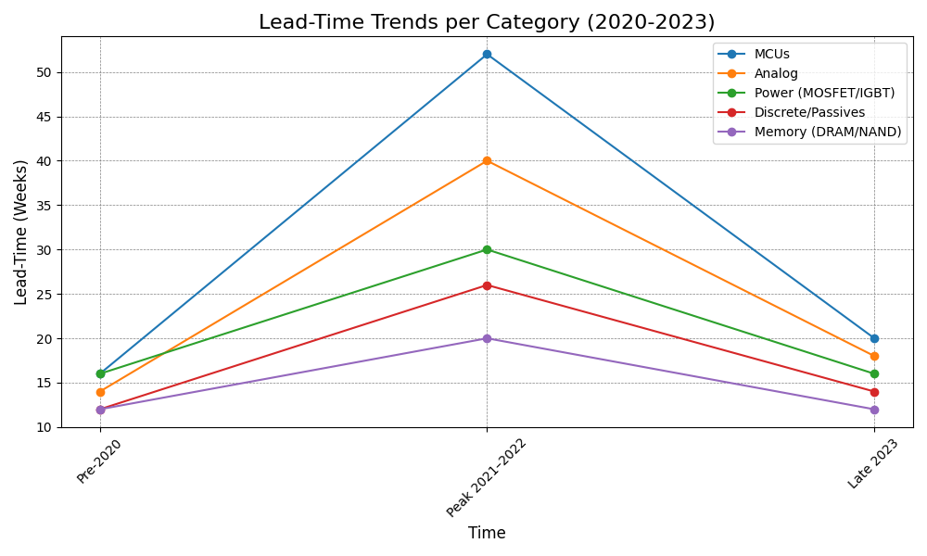
Lead-Time Trend (Weeks): 2020–2023
2021 shocks amplified constraints (weather events, fires, OSAT lockdowns)
Mature-node categories peaked highest; memory cycled sooner
By late 2023, normalization underway but uneven across categories

